Slide 1

Currency Transfer
Created by
Sudhanshu Pathak
Manish rawat
Mentor
Annu sharma

Slide 2
Problem Statement
We have number of payment apps that allows fund transfer across different bank accounts. These applications primarily allow users to transfer the funds in one currency.
Our main aim is to create an application which allows it’s users to transfer funds across different banks and countries. Using this application funds can be transferred in multiple currencies.

Slide 3
Objective / Vision
Design a platform for currency transfer between and within bank accounts. This provides option to transfer between same and multiple currency based on the customers requirement and provides information about the bank account and about previous transaction in the account.

Slide 4
Functional Requirements
Customer should login or register with the platform registering, customer need to provide the following information.
Email-id, Name, Address, Account no, Mobile no, Password.
Customer should login
Customer can access the following services.
Profile edit, add beneficiary, Fund transfer, Account Balance
Currency exchange protocol should be followed .

Slide 5
Non Functional Requirements
Application should be responsive to display consistently across multiple device screens.
There will be an authentication done for each login.
UI should be user friendly.

Slide 6








Technologies In Scope

Slide 7
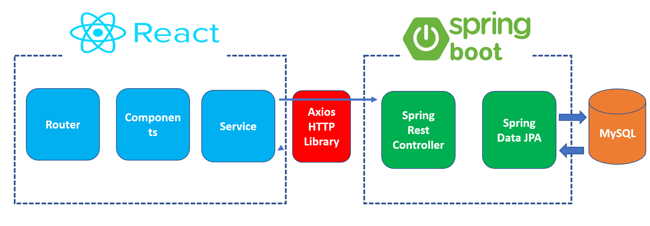
Application Diagram

Slide 8
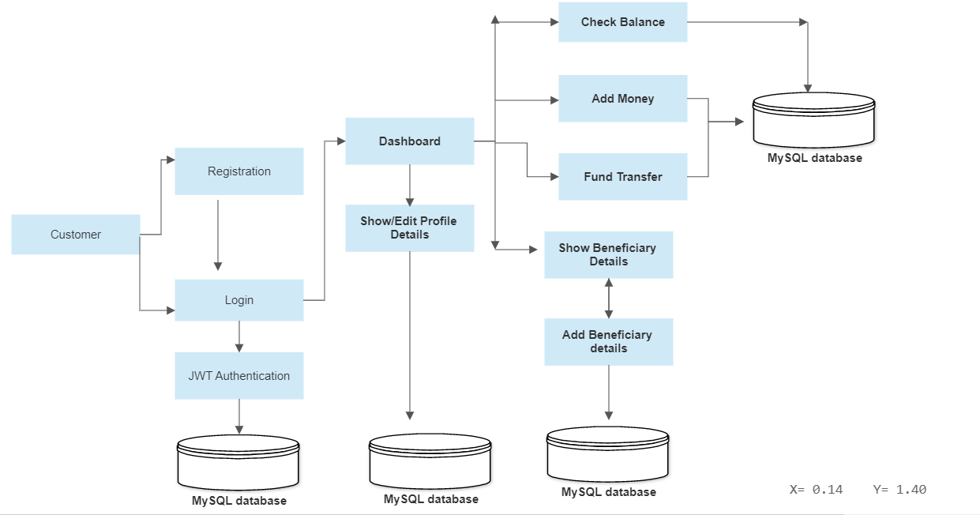
Application Flow

Slide 9

Thank You

